Slide 1
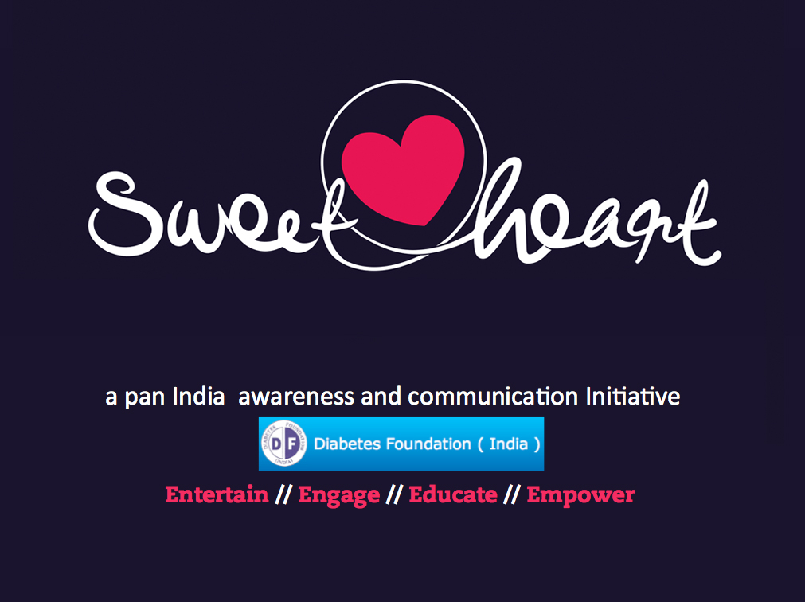

Slide 2
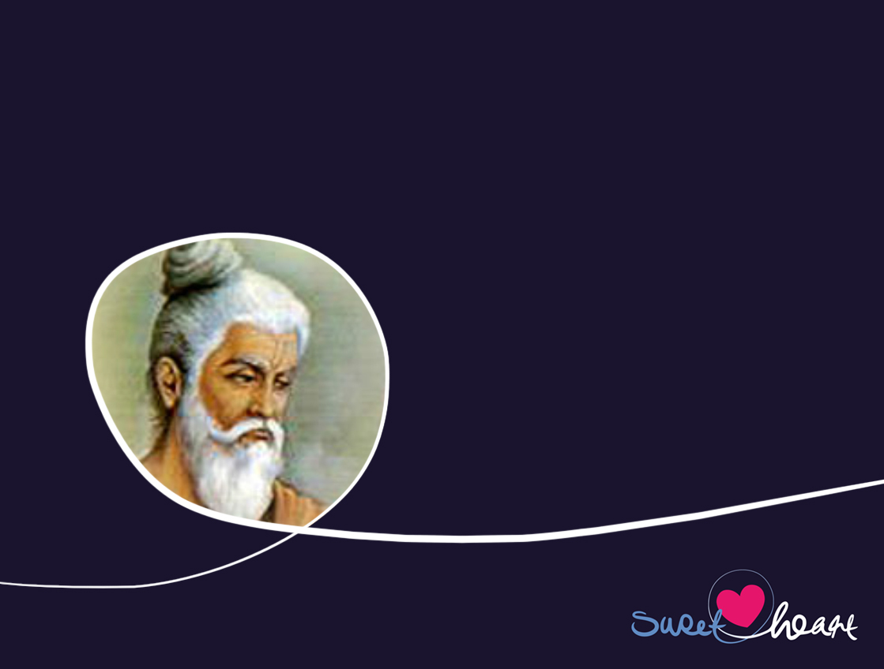

History
In 600 BC - Madhumeha (sweet urine disease) discovered by Indian Physician, Sushruta.

Slide 3

Diabetes:
In 2012 AD
Globally, every 5 seconds, one person develops Diabetes.
In India 1 person dies every 10 seconds from complications due to Diabetes.

Slide 4
Diabetes:
Is an on-going physical condition not a disease.
Is controllable.
Is preventable for those at risk of developing it through lifestyle.

Slide 5

BUT..

Slide 6
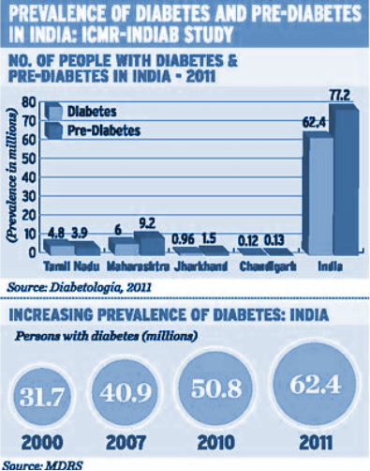
…Today, India has over 62 million people living with Diabetes and an estimated 77 million with pre-diabetes (ICMR 2011).
Every year 200,000 amputations are done in India due to diabetes – a fifth of the global total.
By 2020 the number of people with Diabetes in India could increase to 75 million - 20% of the global diabetes population.

Slide 7
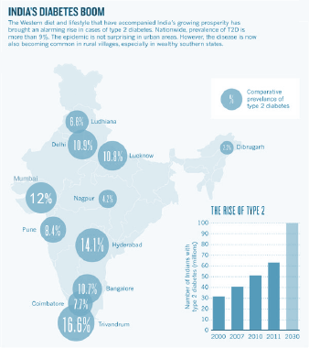
India’s Type 2 Diabetes Boom

Slide 8
The Challenge:
to manage and control Types 1 and 2 Diabetes.
to stem the phenomenal increase in Type 2 Diabetes.
to prevent those at risk developing Type 2 Diabetes

Slide 9
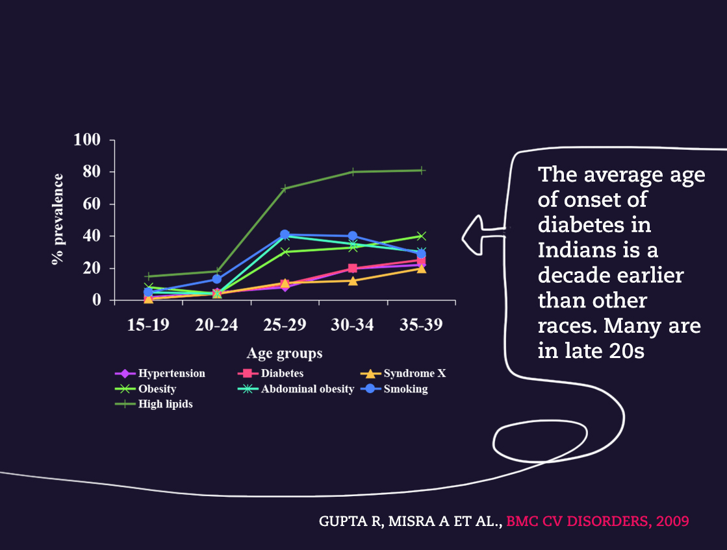
Age-wise Prevalence Trend of Risk Factors:
Males, n=1009

Slide 10
The Problem..
Epidemic growth of Diabetes, particularly Type 2, across India.
The average age of onset of diabetes in India is a decade earlier than other races. Many are in their late 20s.
Wide Diversity in patient profiles – language, culture, economy, education and lifestyle.
Poor understanding of the causality and treatment of Diabetes.
Negative approach in prognosis communication
Lack of sufficient, effective distribution systems of education.

Slide 11
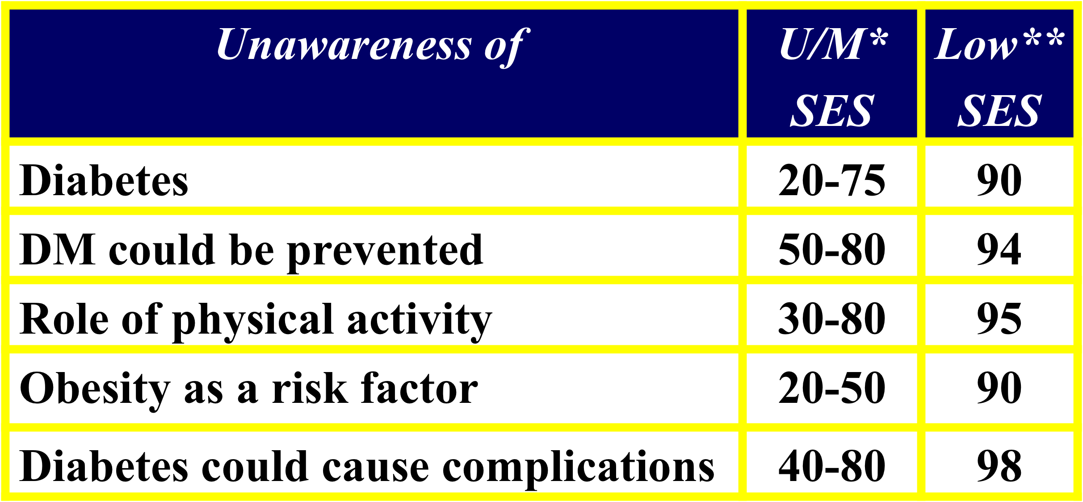
SES: Socio-economic stratum, *: Data from Mohan et al., **: Data from urban slums, Misra et al.

Slide 12
The solution:
A positive and wide-reaching campaign that will:
address the diverse social, economic and lingual challenges in the communication and dissemination of diabetes education.
stimulate a platform for social and behavioral change.
create a long term strategy for sustainability.

Slide 13
The Sweetheart Initiative has the potential to:
create a platform for Social and Behavioural change both in the control and management of Types 1 and 2 diabetes and the prevention of Type 2.
disseminate simple, accessible, multi-lingual education on Types 1 and 2 Diabetes (including Hypertension) across the diversity of age, economy and culture in India.
encourage early diagnosis, prevent unnecessary suffering and improve the lives of people living with diabetes across India and the Indian Diaspora
sustain an interactive Education programme with an initial 3-5 year strategy.
use entertainment as a means to engage, educate and empower with multi platform delivery from print to TV and film and animation to viral.

Slide 14

The Method.

Slide 15
1. The Movie
Sweetheart - a feature length Bollywood movie with live action, animation and 2/3D animation.
When Manu, school clown, sweetheart and junk food addict, collapses in the middle of her big number in the school musical, she comes face to face with the shadow of diabetes, now her life-long condition. With the help of her best friend, Jahnavi, her mom, and some empowering new buddies, both live and animated, Manu learns how to manage her diabetes, helps prevent others develop it and discovers the power of the body to regenerate. Just like the sun which nurtures and heals, Manu, through a magical journey of self discovery, unravels and shares the sunshine within her.
Aamir Khan's Taare Zameen Par (Like Stars on Earth) looked at Dyslexia in a similar way and raised awareness throughout India and internationally.

Slide 16
1. Multi-Media Education on prevention, management and change of lifestyle
on-going series of short animated films using characters from the movie
comic strip
mobile phone – interactivity and messaging with icons and jingles
interactive website
music videos and DVDs
games – board, computer and mobile
books, print, visual aids
posters

Slide 17


Dissemination Targets and Channels

Slide 18
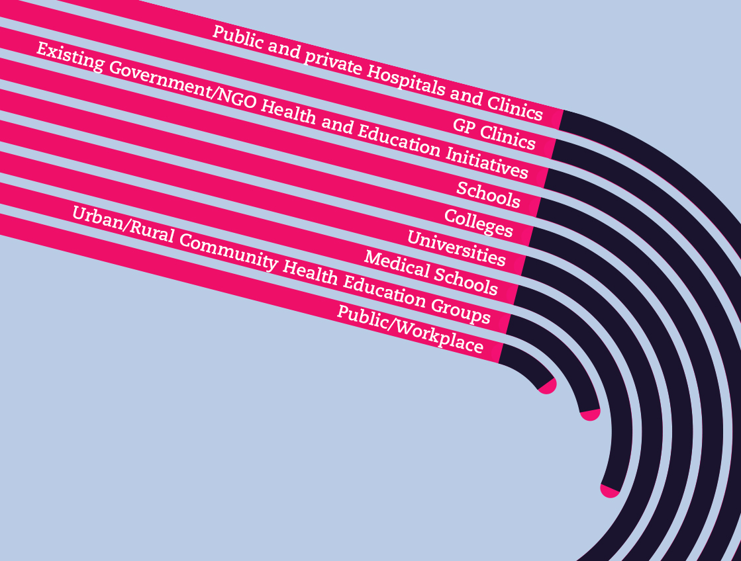
Distribution Targets

Slide 19
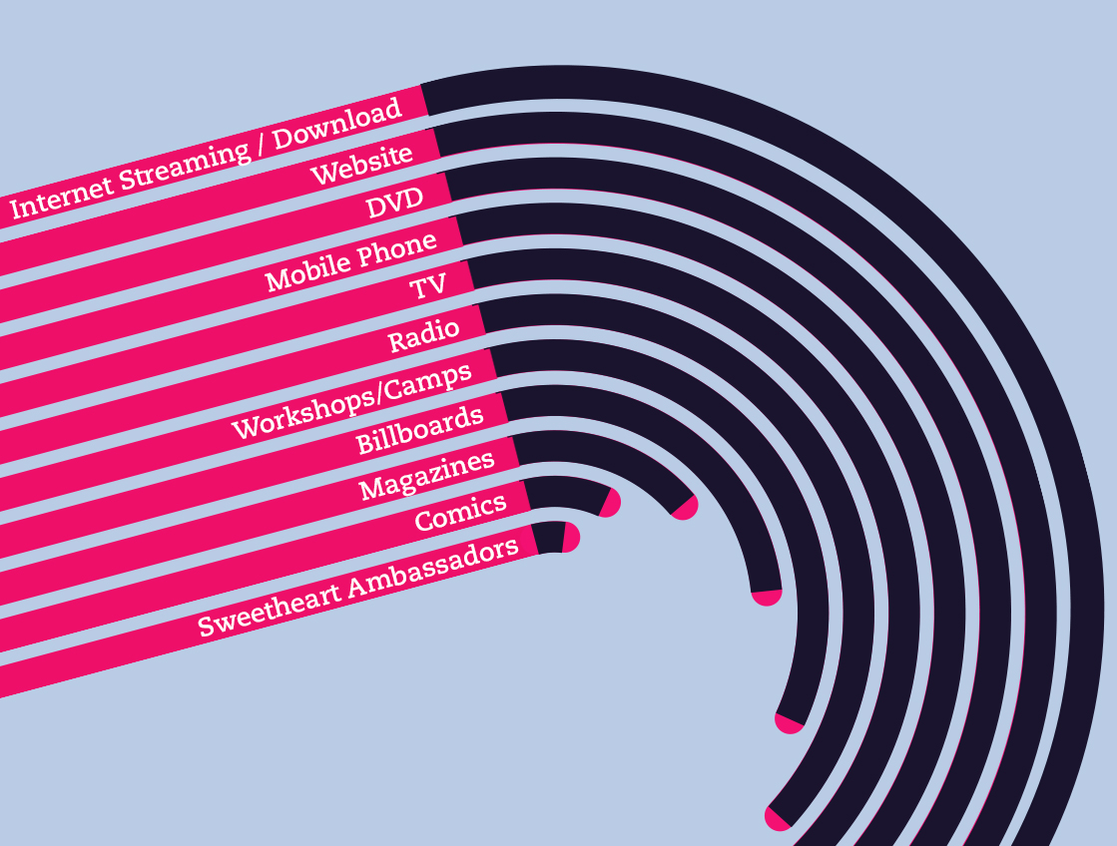
Distribution Channels

Slide 20
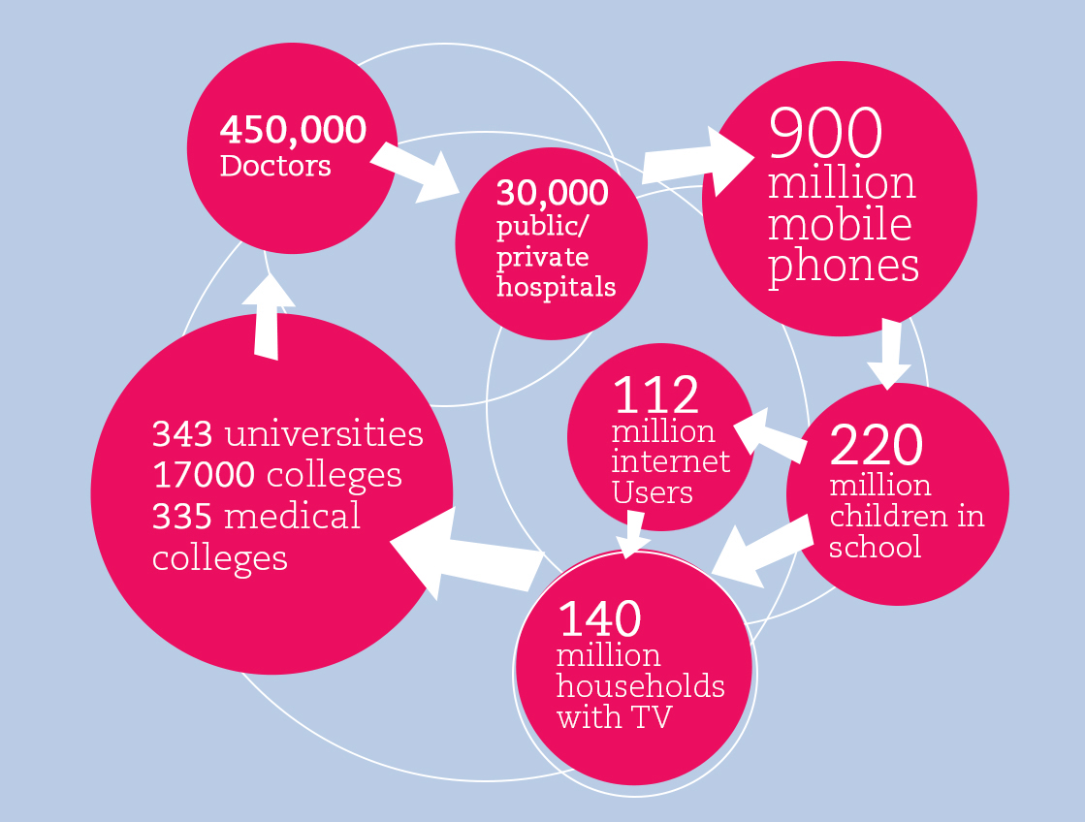
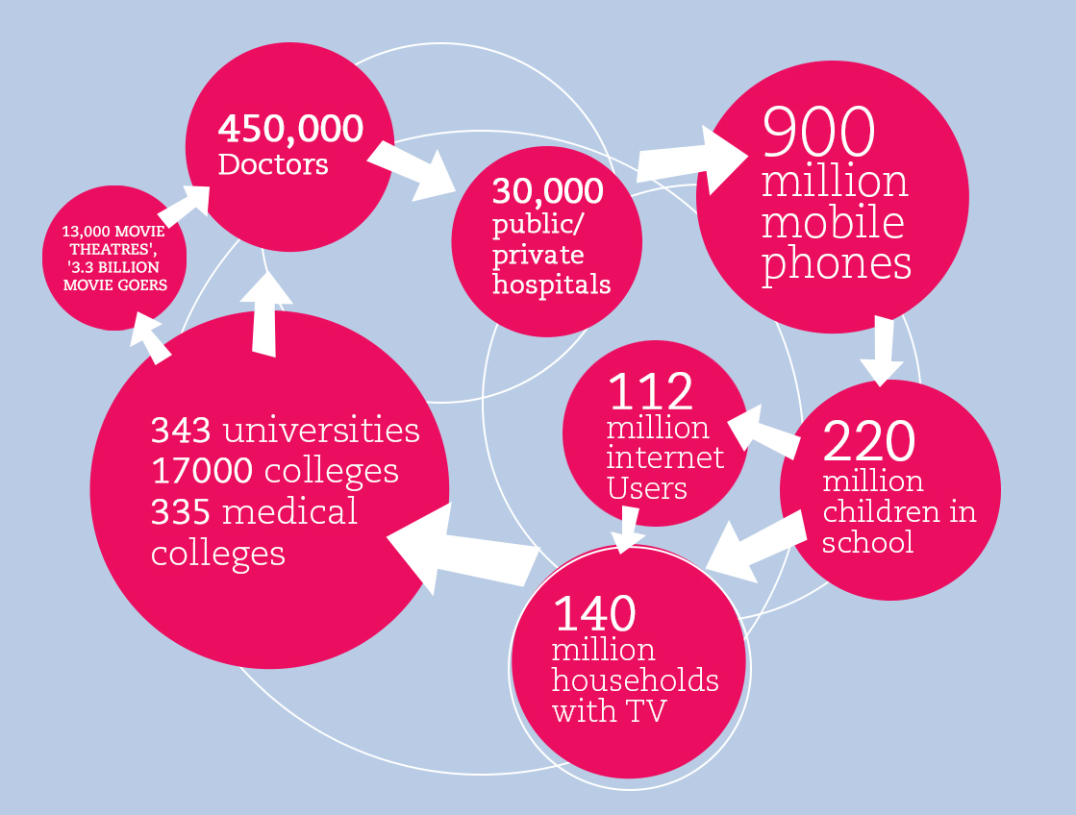

Slide 21
Why mobile Phone
Huge number of mobile phones in use in India – over 900 million in March 2012 (Wikipedia).
Great potential to deliver health messages, measure and share data and ‘nudge’ on prevention, management control and lifestyle (both in audio and vision to cover the wide range and capabilities of handsets).
Enhance Sweetheart Initiative reach with simultaneous mobile campaign

Slide 22
Why Sweetheart the Movie?
Launch the Sweetheart Initiative
Raise Awareness
Reach the maximum number of people across India and Internationally through Movie Houses, Mobile Screens, Clinics, Streamed online Premieres and Community Screens.
Subliminal Health and Lifestyle Education
Positive association with characters – real and animated
Platform to support the Education Programme

Slide 23
Movie distribution Method
theatres – Nationally and Internationally
mobile Screens
TV
online Streaming and Download
DVD
mobile phone

Slide 24

Development // Production // Dissemination

Slide 25
Sweetheart Stage 1
Develop Movie to Post Production and final print.
Develop and produce Animated content for the Movie and
Short Animated Films for the Education Programme.
Develop and produce Sweetheart Phone App.
Develop and construct Interactive Web Site with IPTV facility.
Develop other initial multi-platform, multi-media Education Material – comic book, games, AV interactivity etc.
Co-ordinate and Facilitate Education Dissemination Strategy.

Slide 26
Sweetheart Stage 2
Promotion and Launch of Movie, Phone App, Website, Short Animated Films, Education Programme and Music Videos.
Distribution of Movie and Phone App.
Dissemination of Short animated Films and full Education Programme.

Slide 27
Sweetheart Stage 3 (not covered by initial funding)
Analysis and assessment based on Education feedback and development and production of new Short Films and other material to satisfy the need identified from it for further focus on health and lifestyle messages.
Continuous assessment of short term results and long term potential.
On-going development and updating of interactive
distribution platforms and material.
On-going support for the network of Sweetheart Ambassadors in schools, colleges, communities, health care etc.
Assessment and review of dissemination strategies.
Sustain Sweetheart Trust.

Slide 28
Potential Impact of Sweetheart Initiative
Less shadow more sunshine in attitudes to diabetes
Sustainable Social and Behavioural Change.
Raised Awareness and Understanding of Types 1 and 2 Diabetes.
Improved Control and Management of Diabetes.
Decrease in population developing Type 2 Diabetes.
More positive communication.
Decrease of unnecessary suffering and hardship.

Slide 29
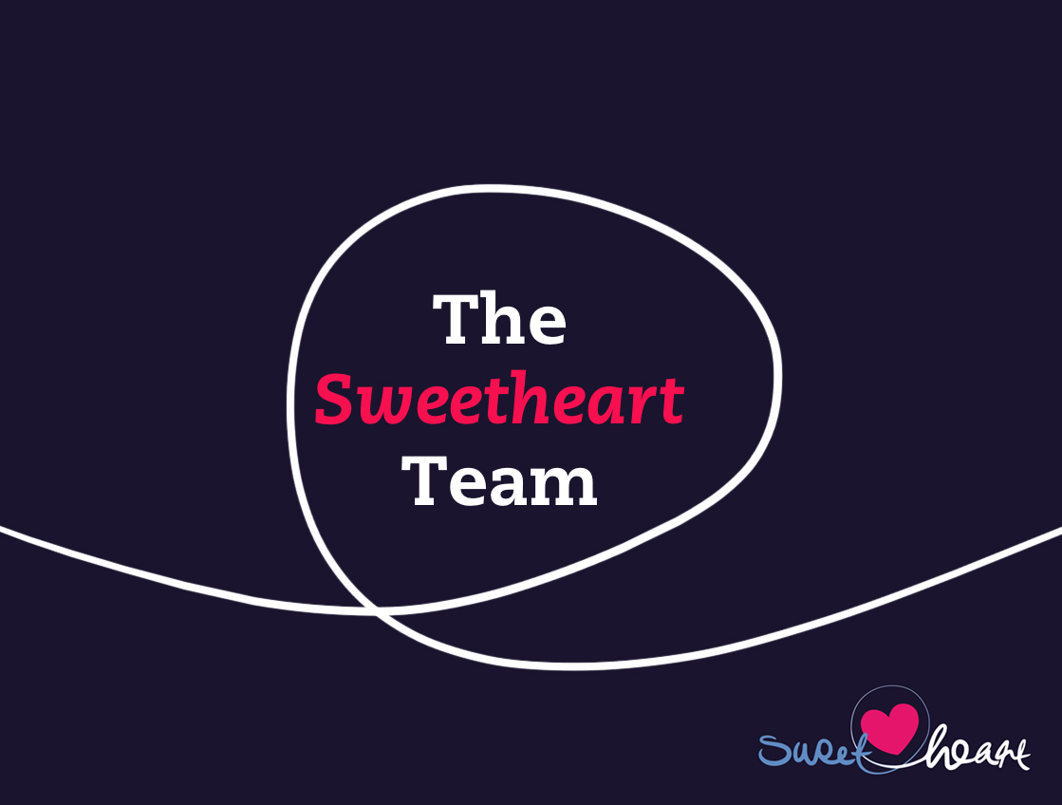
The Sweetheart Team

Slide 30
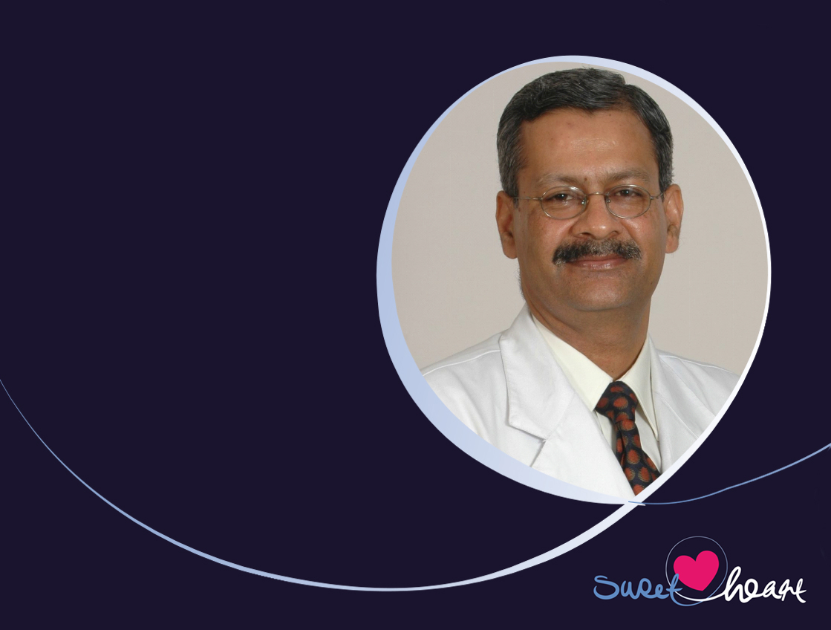
Dr Anoop Misra
HEAD – Sweetheart Initiative
Chairman Fortis-C-DOC Centre of Excellence for Diabetes, Metabolic Diseases and Endocrinology
Director,Centre of Internal Medicine (CIM), Fortis Hospital, Vasant Kunj, New Delhi
Chairman,National Diabetes, Obesity and Cholesterol Foundation (N-DOC)
Director,Diabetes and Metabolic Diseases, Diabetes Foundation (India) (DFI)

Slide 31
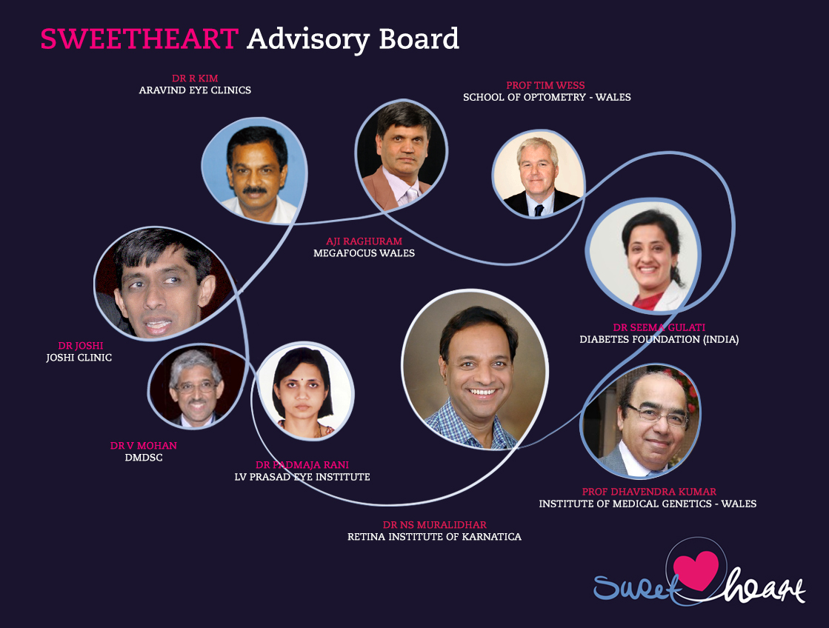
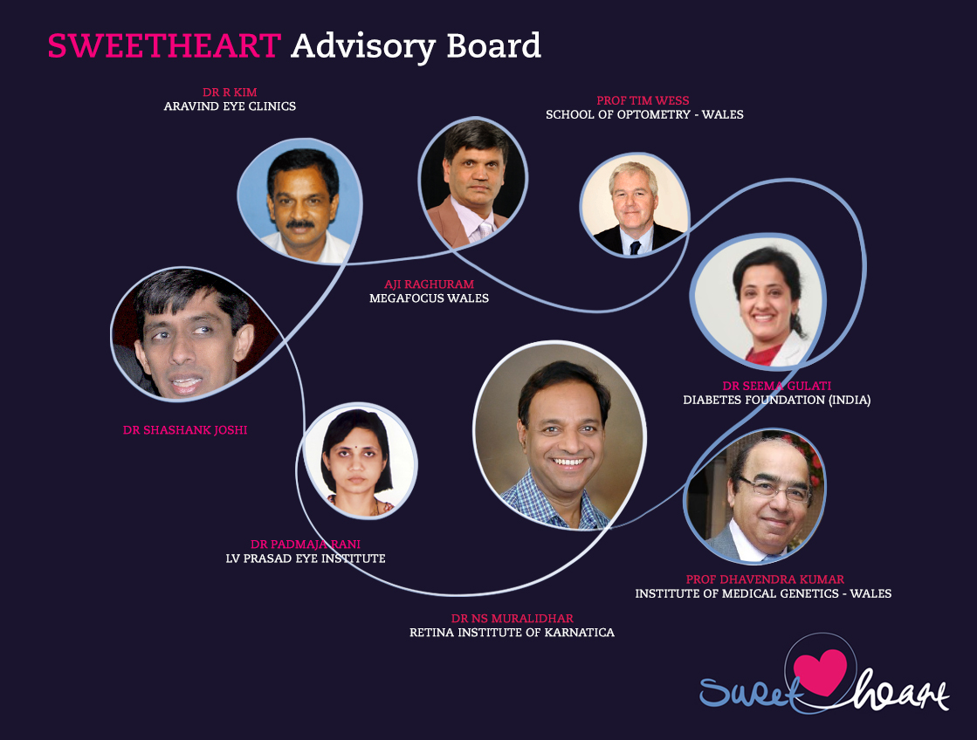

Slide 32
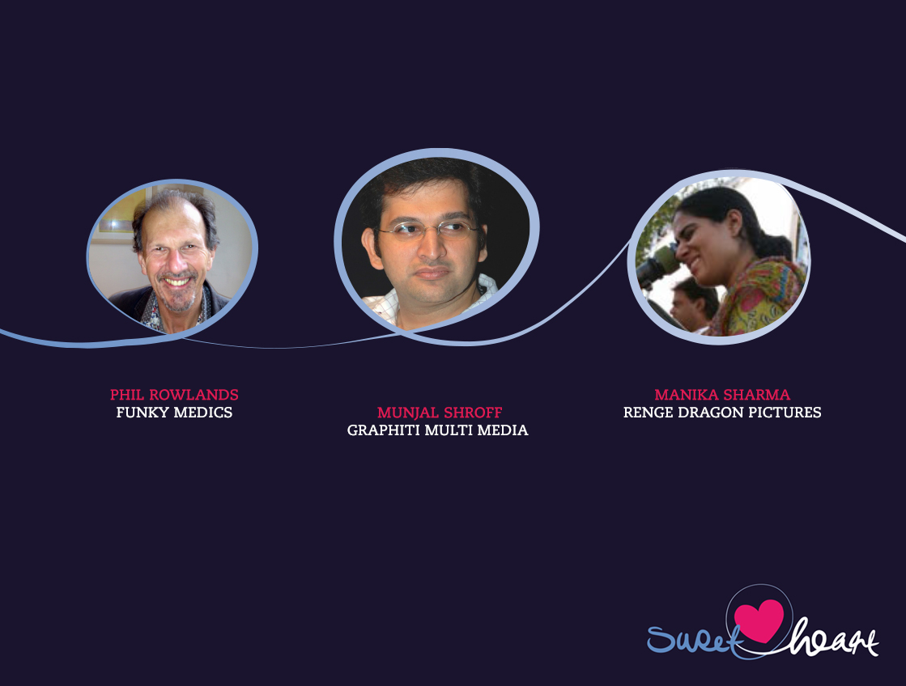
Sweetheart Initiative Directors

Slide 33
Funding Breakdown
Sweetheart Movie – INR 71,228,000
Sweetheart Education Programme – INR 25,593,000
Sweetheart Project Development Co-ordination and Management – INR 18,718,000
Sweetheart Grand Total – INR 115,539,000

Slide 34
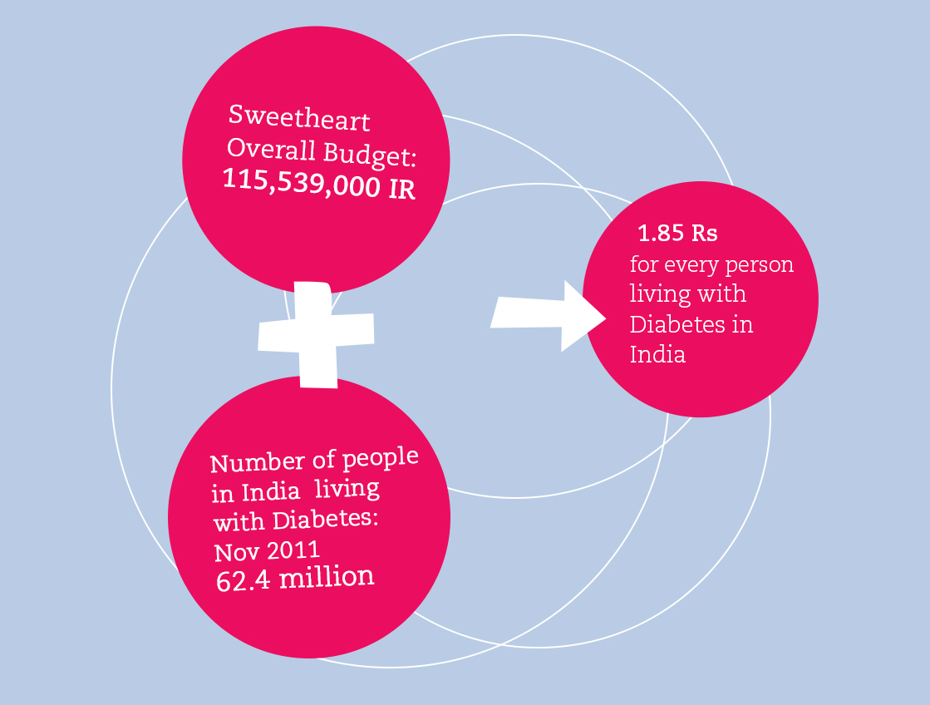

Slide 35
Sweetheart Initiative Directors
All Sponsorship Funding will be facilitated through the Diabetes Foundation (India) ‘Sweetheart’ Initiative

Slide 36
Sponsor Benefits
The ‘Sweetheart Initiative’ is year on year sustainable and the product character recognition will be ongoing.
Product Visibility – logo, brand name and corporate colour.
Animated Sponsor Product characters will be an integral part of the narrative of the story and will feature in the musical productions. They will also feature as a core part of the education programme.
Stand alone music videos with a huge potential coverage by music stations, radio, TV, cinema, DVD, mobile phone downloads and online.
All character content - movie, films, music video etc, accessible for view and download on the ‘Sweetheart’ website as well as the Sponsor site.
Visibility and ongoing product recognition through Press launches, Premieres and all focused PR through association with the ‘Sweetheart’ brand.

